Slide 1
AHFA Compliance Training for AAHA
AHFA Data Management System (DMS)

Slide 2
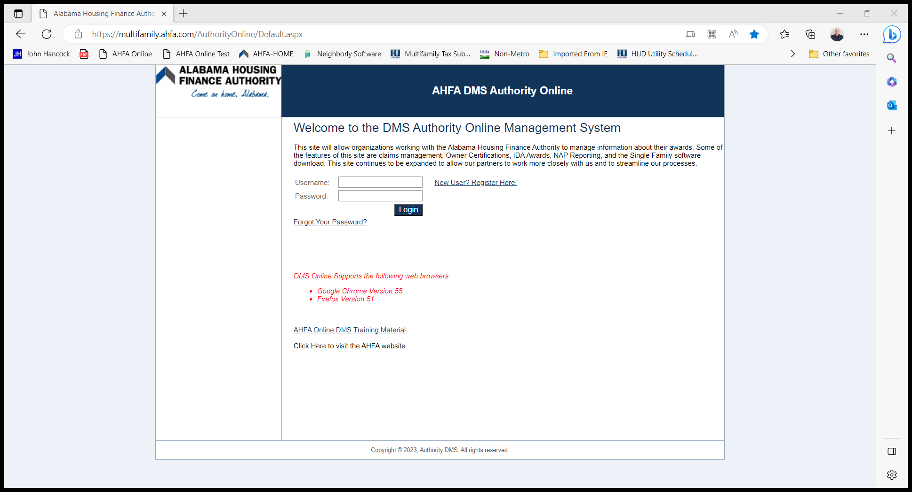
AHFA DMS
This is the logon page.
A link can be found by going to the online management system in the compliance section of www.ahfa.com.

Slide 3
AHFA DMS
New User? Register Here.
Link to Training Material for AHFA DMS.
Link to get a Temporary Password.
Login to the system for Approved Users.

Slide 4

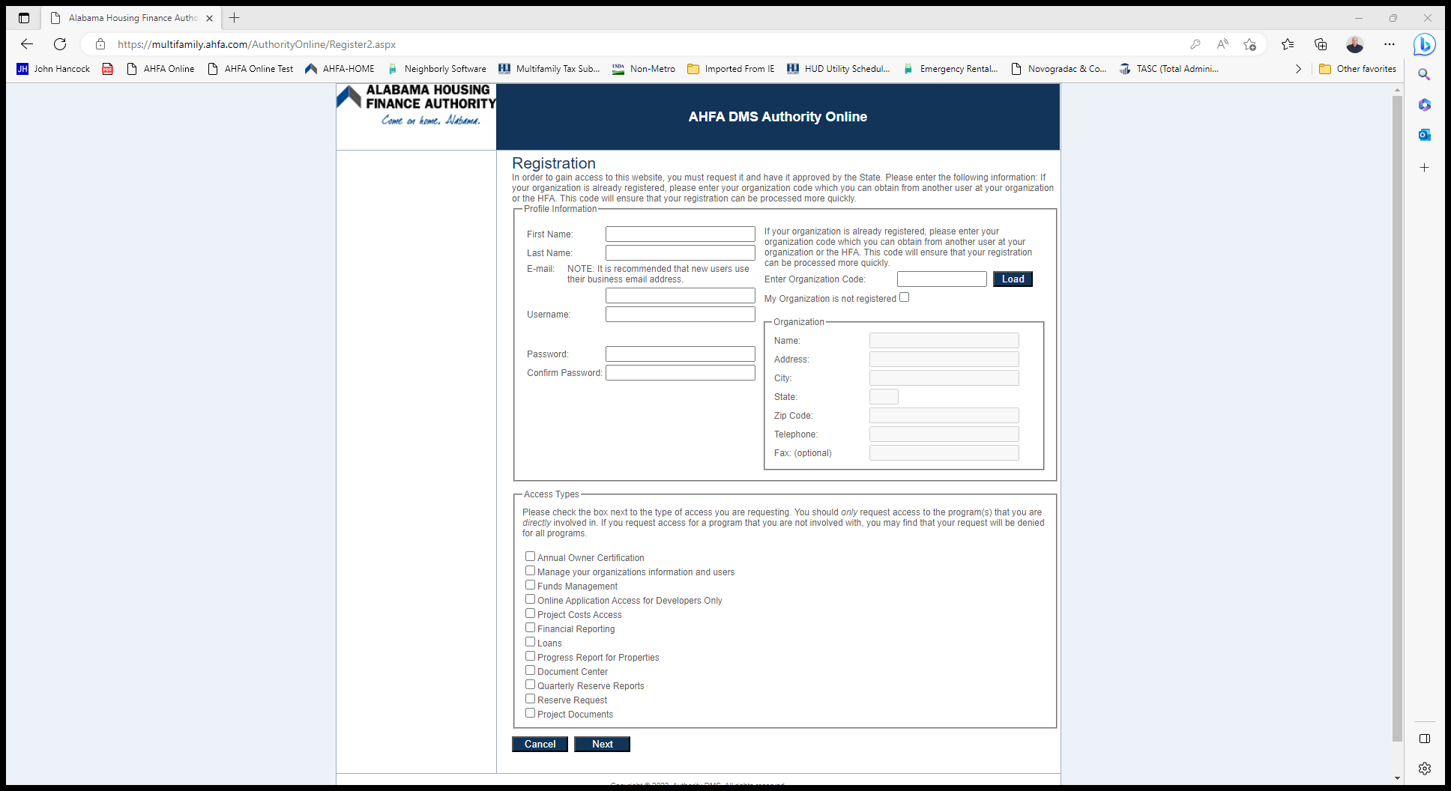
AHFA DMS
To Register you will need the following:
Award Number for your Property
Organization Code for your Company
Username: you make this up, but I do not recommend using your company email address.
Password: must be 7 characters with at least one number.
Access Types: This depends on your roll with your company.
Annual Owner Certification gives the user access to the property and to enter tenant data.
Manage your organization information and users if for the Owner.
Document Center will give you access to the Portal to send and receive documentation.

Slide 5
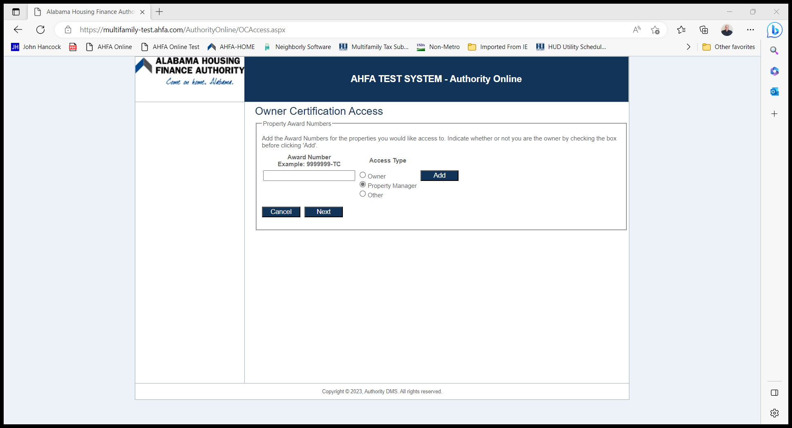
AHFA dMS
Enter Award Number
Click the box beside Owner, Property Manager, Other (whichever applies)
Click Add
Click Next
Click Submit
Tip: Once you have successfully submitted the request let your owner know. If you are applying for Owner access, then email AHFA Compliance. The request is immediately sent once it has been submitted.
Once the request is approved you are ready to begin.

Slide 6
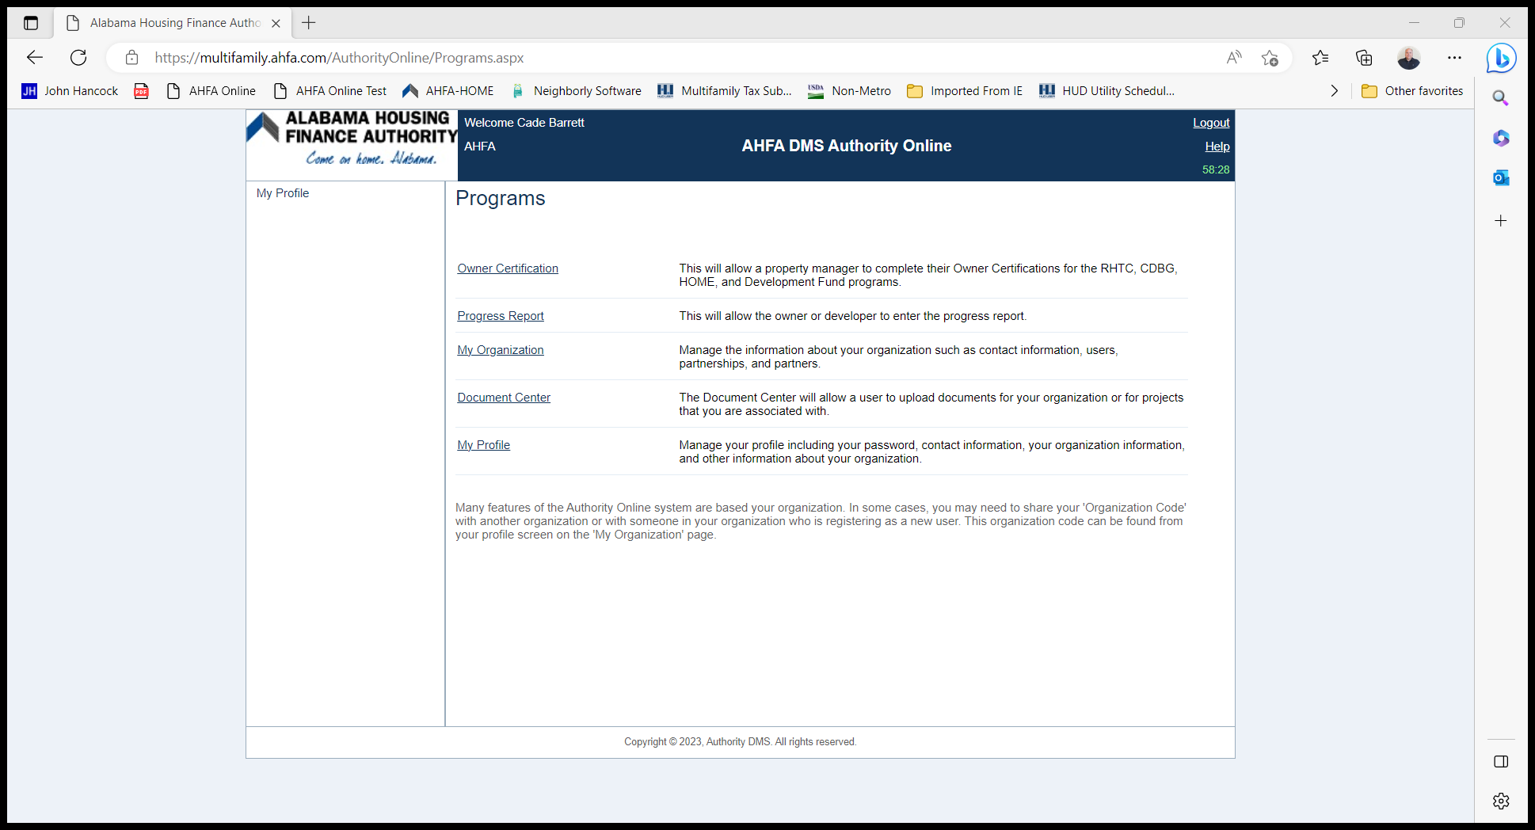
Programs
- Owner Certification
  Once you have been approved, you will see this as a Program choice.
  To access your property, click Owner Certification

Slide 7
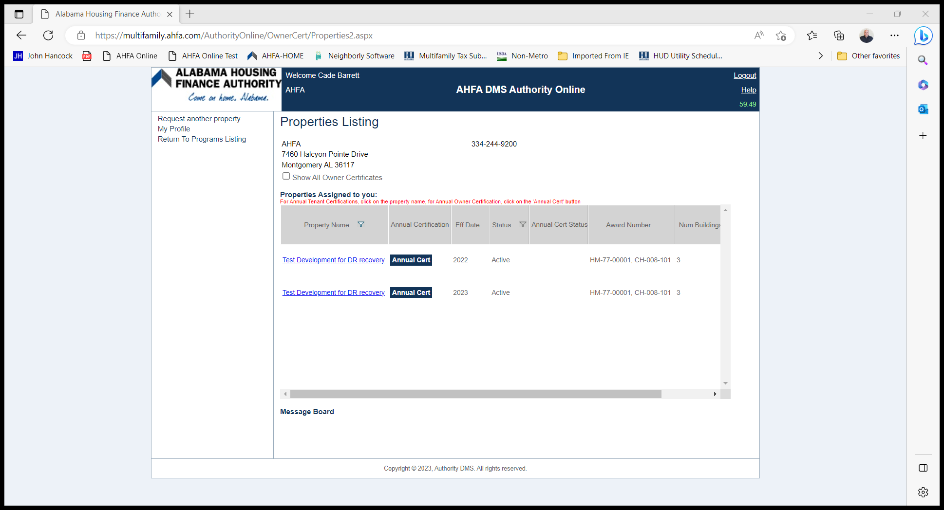
Property Listing
You will only see the current and previous effective year.
To see more years, just check the box beside “Show All Owner Certifications”

Slide 8
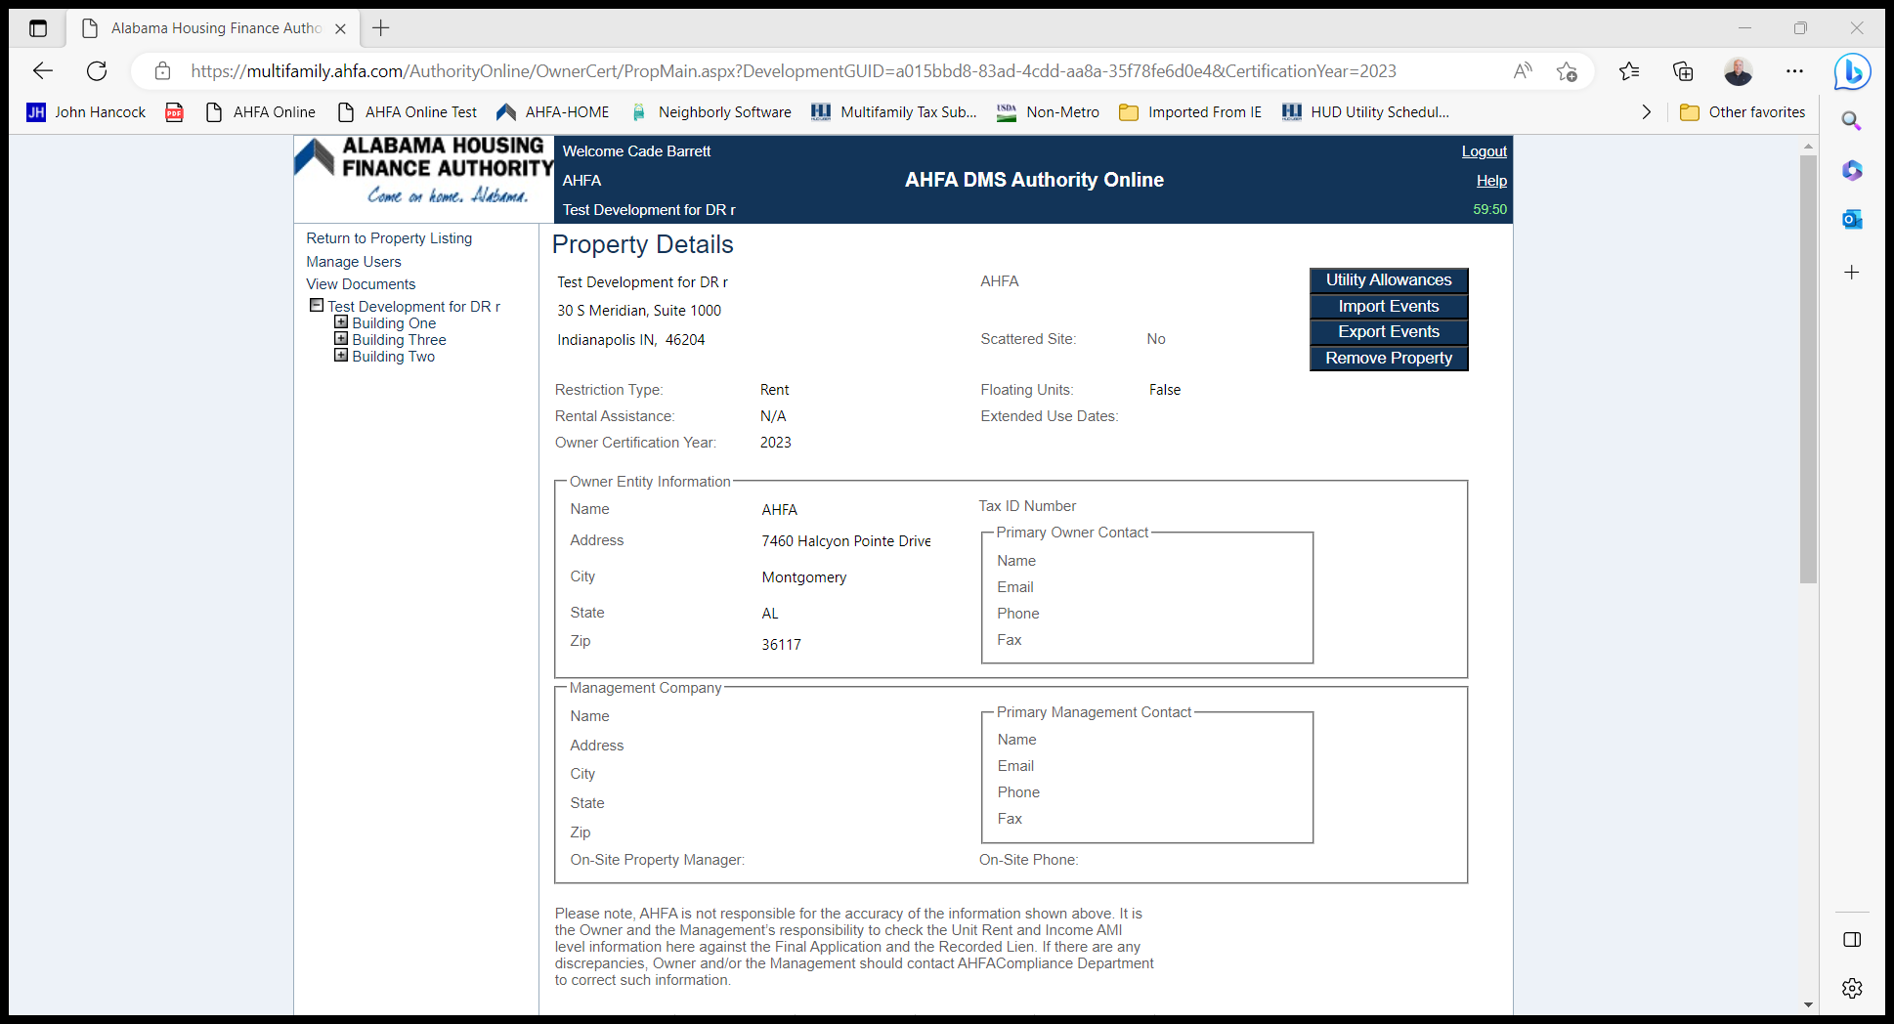
Property Details
See and Create Utility Allowance(s)
Import Events
Export Events
Create Units
Enter and Review Tenant Events

Slide 9
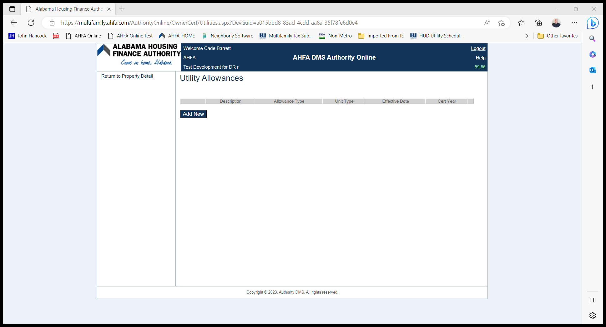
Utility Allowances
This screen shows you what has been created and gives you an option to create the utility allowance by clicking “Add New”.

Slide 10
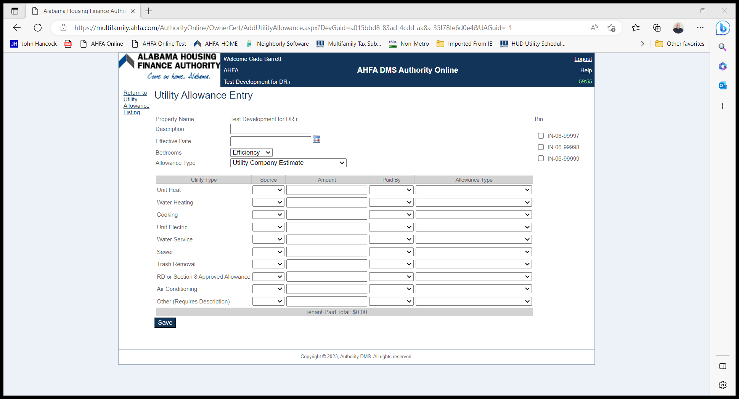
Utility Allowances
The following are required in order to create the Utility Allowance:
Description
Effective Date
Unit Type
Allowance Type
At least one BIN selected

Slide 11
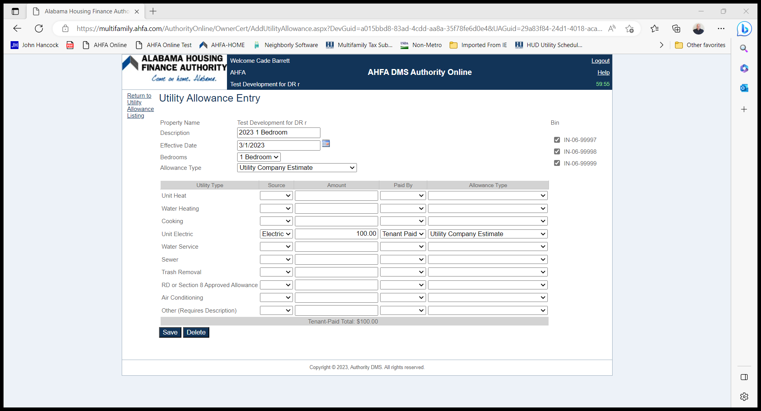
Utility Allowance
Tips
Do not just name the utility allowance…. Utility Allowance.
Common Errors
Effective Date
BIN not selected
Allowance Type
Tenant Paid/Owner Paid

Slide 12
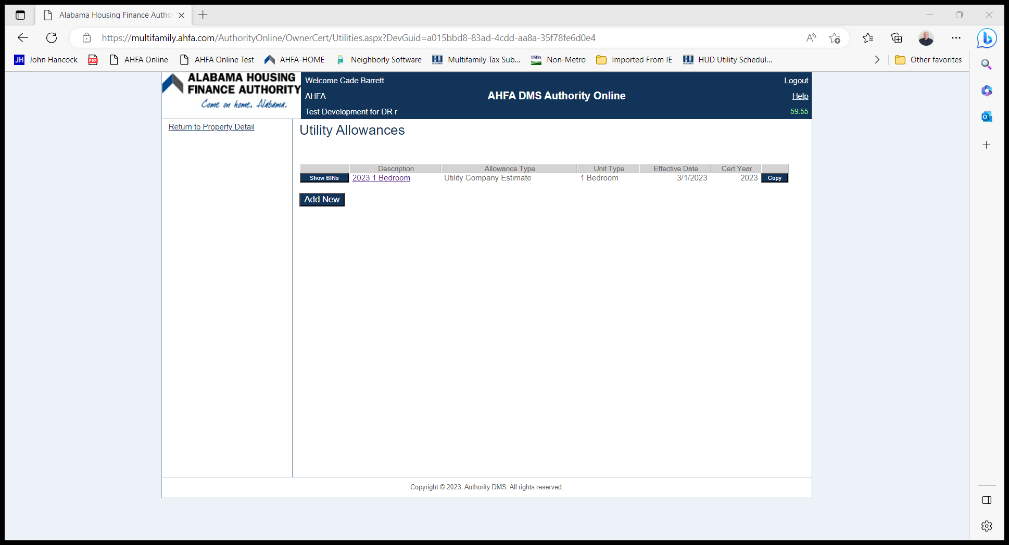
Utility Allowances
Once completed you will see the utility allowance you created on this screen.
How often must this be updated?
Annually
When the new utility allowance is released
Begin using a different utility allowance option
All of the above

Slide 13

How to create a Unit
Click on the Building Identification Number (BIN)

Slide 14
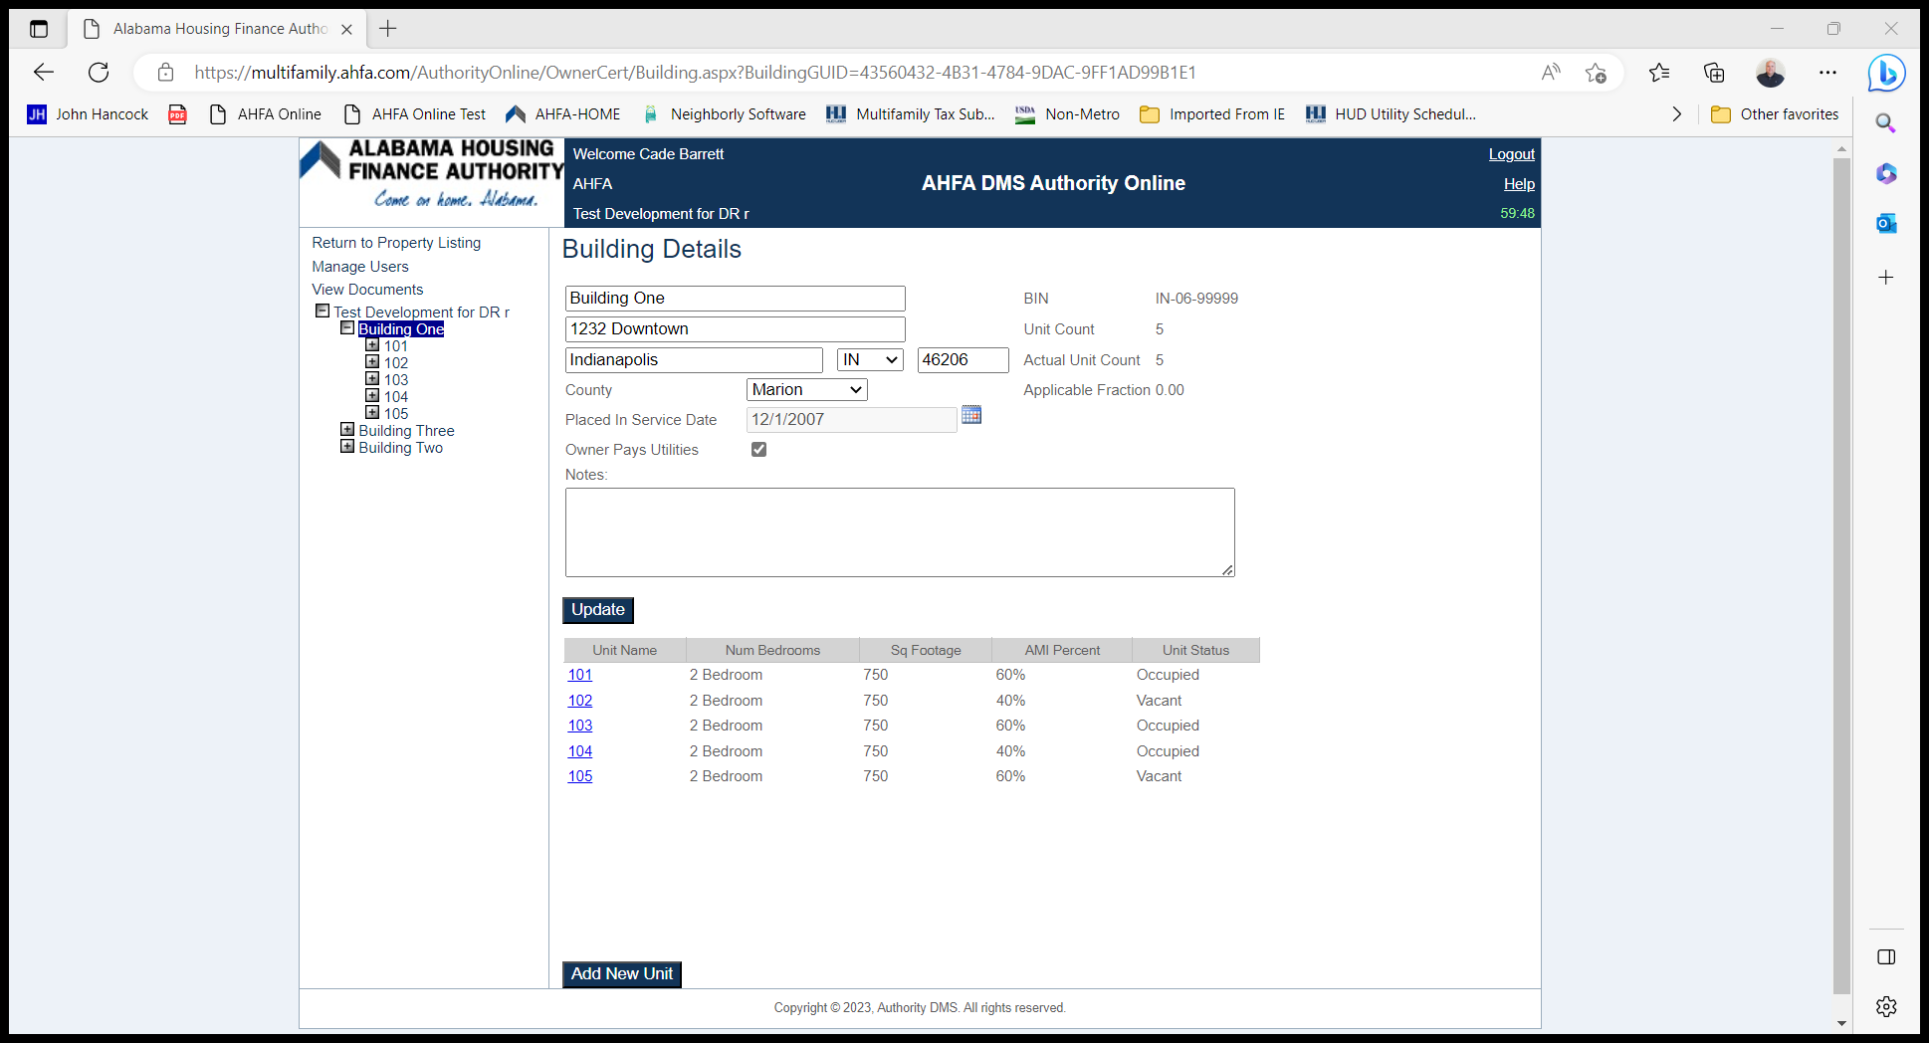
Building Details
Edit information about your property and create Units on this screen.
Click “Add New Unit” to go to the Unit Information screen.

Slide 15
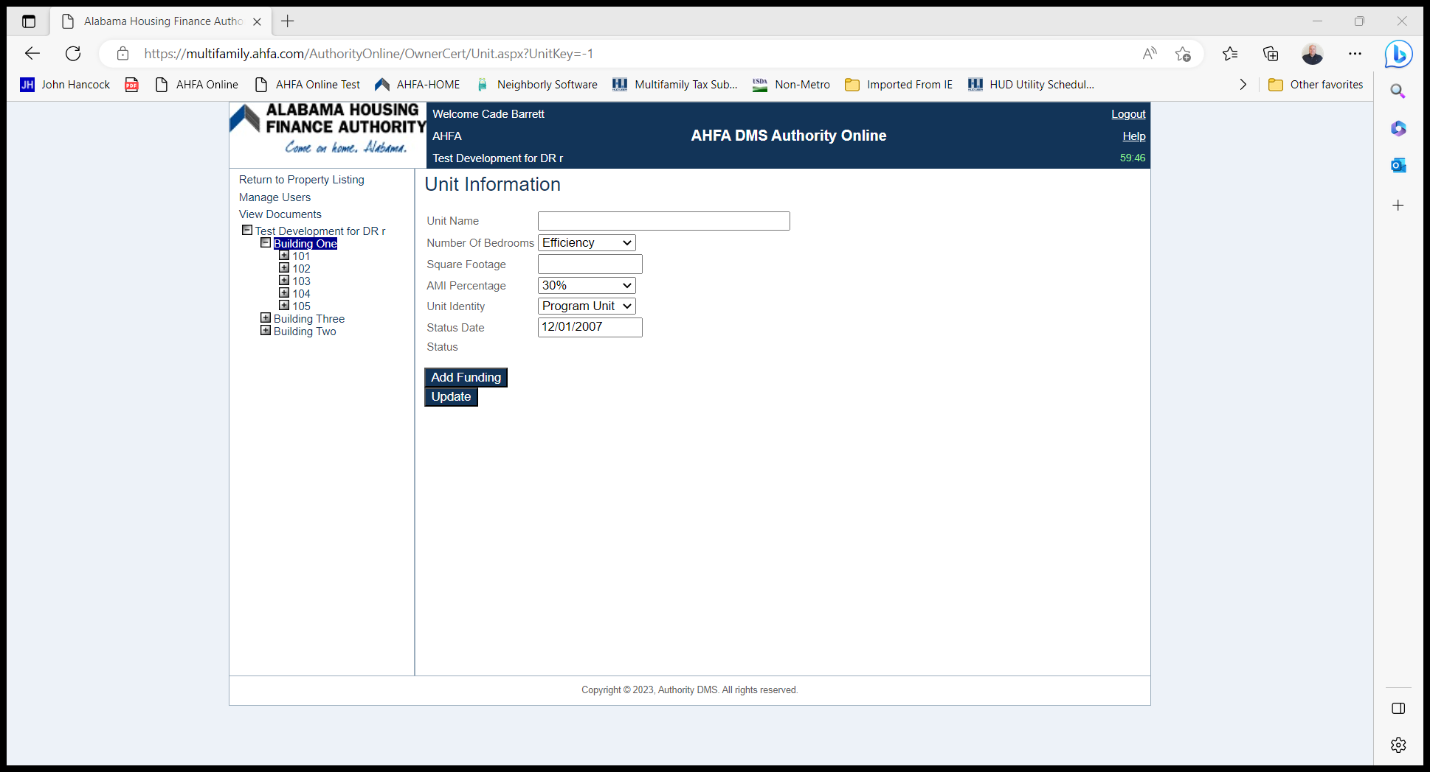
Unit Information
Enter information about the unit
Low Income Units are referred to as a Program Unit
It is VERY important to Add Funding
  At a minimum you will want to add the Start Date for the funding program(s) the property received (Tax Credit, HOME, Housing Trust Fund, etc.)

Slide 16
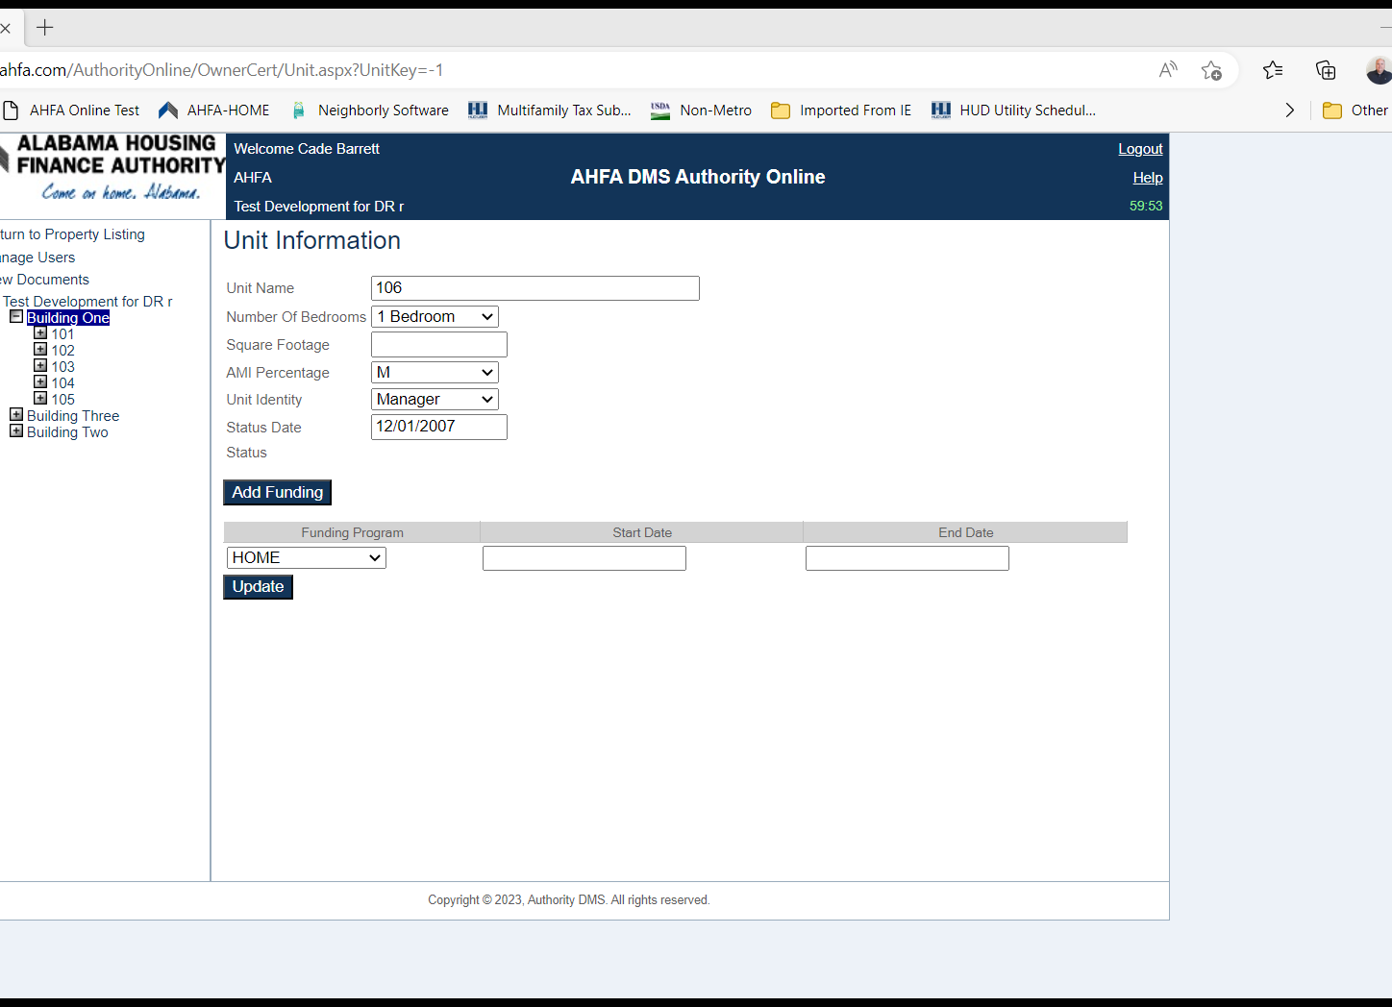
Staff Unit or Courtesy Officer Unit
Manager Unit
  AMI Percentage choose “M”
  Unit Identity choose “Manager”
  Courtesy Officer Unit
  AMI Percentage choose “M”
  Unit Identity choose “Security”

Slide 17
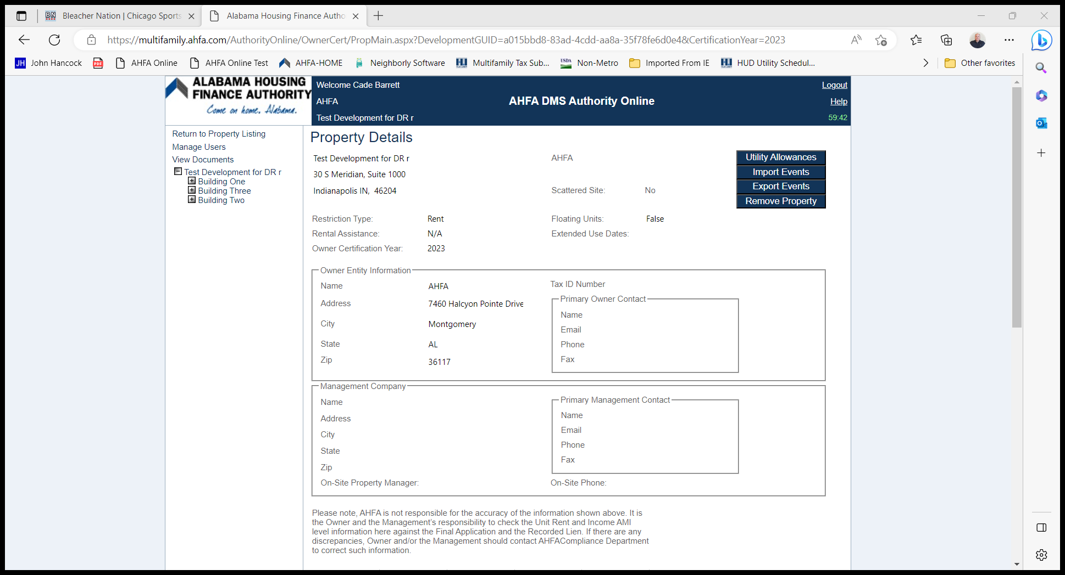
Unit Information
Click on the + beside the Building Number

Slide 18
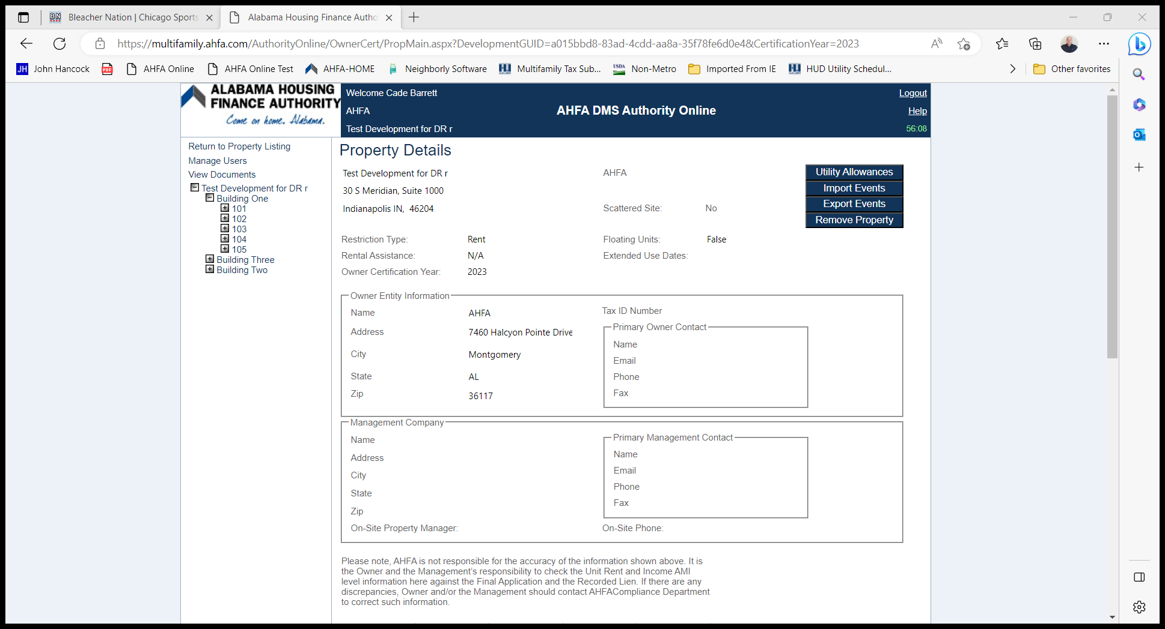
Unit Information
Click on the + beside the Unit Number

Slide 19

Unit Information
Click “Add New Event”

Slide 20
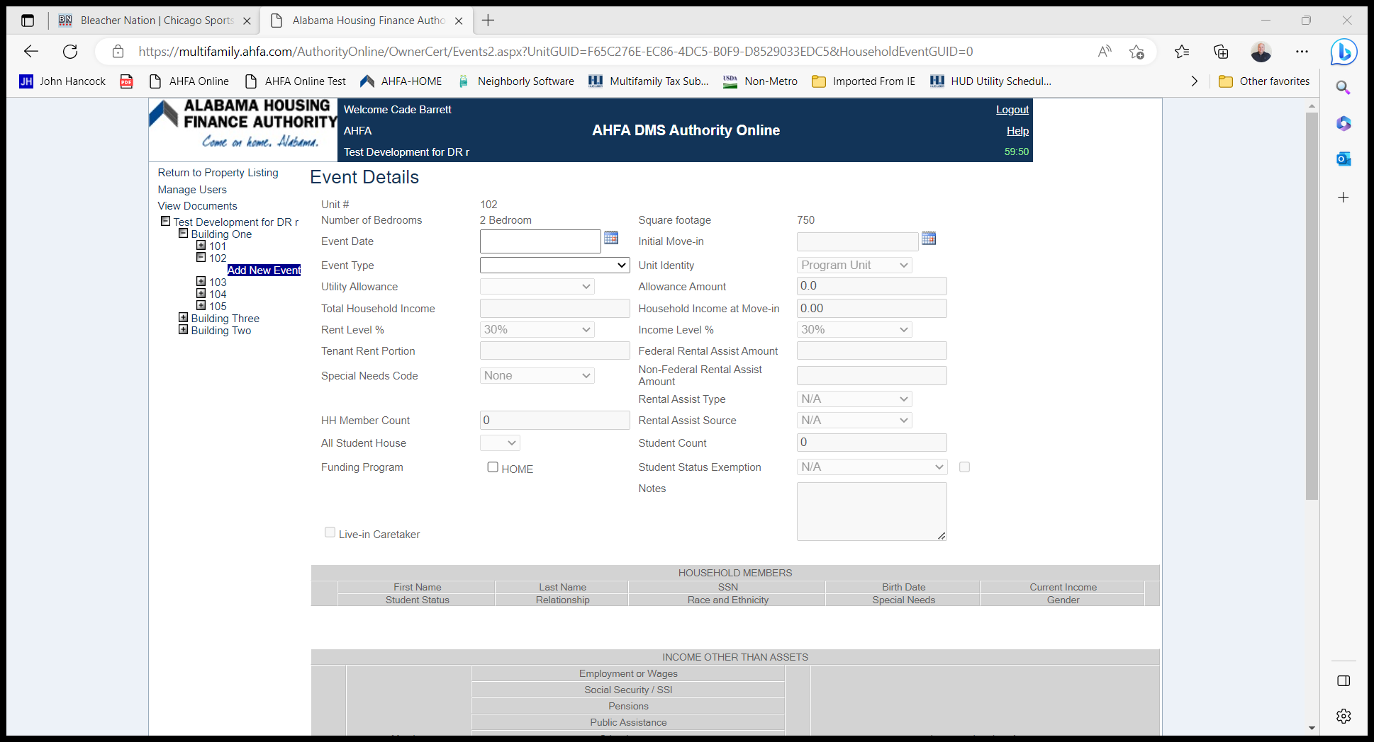
Event Details
Enter the Event Date
  This is the actual date of move-in or date of the event
  If entering a Recertify, this is NOT a date exactly one year from the Effective Date
Choose the Event Type
All cells MUST have an answer
Choose the appropriate Rent Level % and Income Level %
Choose the appropriate Funding Program for the property
The Non-Asset Income and Asset Income sections are now mandatory

Slide 21

Event Details
Make sure to choose the correct % for the Income and Rent Level
To do this you will need to know what the set-aside requirement is for the property.
Below are a few examples of the different set-aside options:
100% at 60%
40% at 50%; 60% at 60%
20% at 50%; 80% at 60%
30%
100% at 50% (Rent); 100% at 60% (Income)
100% at 50% (Rent); 40% at 50%, 60% at 60% (Income)

Slide 22
Event Details
Example:
Total Units in the Property: 40
5 Buildings
8 Units in each Building
Funded in 2007
Received Tax Credit and HOME funds
Set-Aside Requirement is 40% at 50%, 60% at 60% per Building
How many units must be within the 50% Income and Rent Level in each Building?

Slide 23
Event details
4

Slide 24
Funding Program
Two methods to choose the Funding Programs
  Choose all funding programs the property received.
  Choose only the Funding Program that is appropriate for the household.

Slide 25
Funding Program
Example:
Property received Tax Credit, HOME, and Housing Trust Funds
Program Start Date End Date
Tax Credit 1/1/2000 12/31/2030
HOME 1/1/2002 1/1/2022
Housing Trust Fund 1/1/2000 12/31/2030
If the Event Date is 5/22/2020 and this is not a HTF Unit, what would be your funding program choice?
If the Event Date is 5/22/2023 and this is not a HTF Unit, what would be your funding program choice?
If this is a HTF unit, what is the funding program choice?

Slide 26
Funding program
Answers:
HOME
Tax Credit
Housing Trust Fund
Only checking the appropriate funding program will guarantee the system will be using the appropriate income and rent limits to check for compliance for the event.
I have been assured if you choose all the funding programs that apply to the property the system will choose the most restrictive.

Slide 27
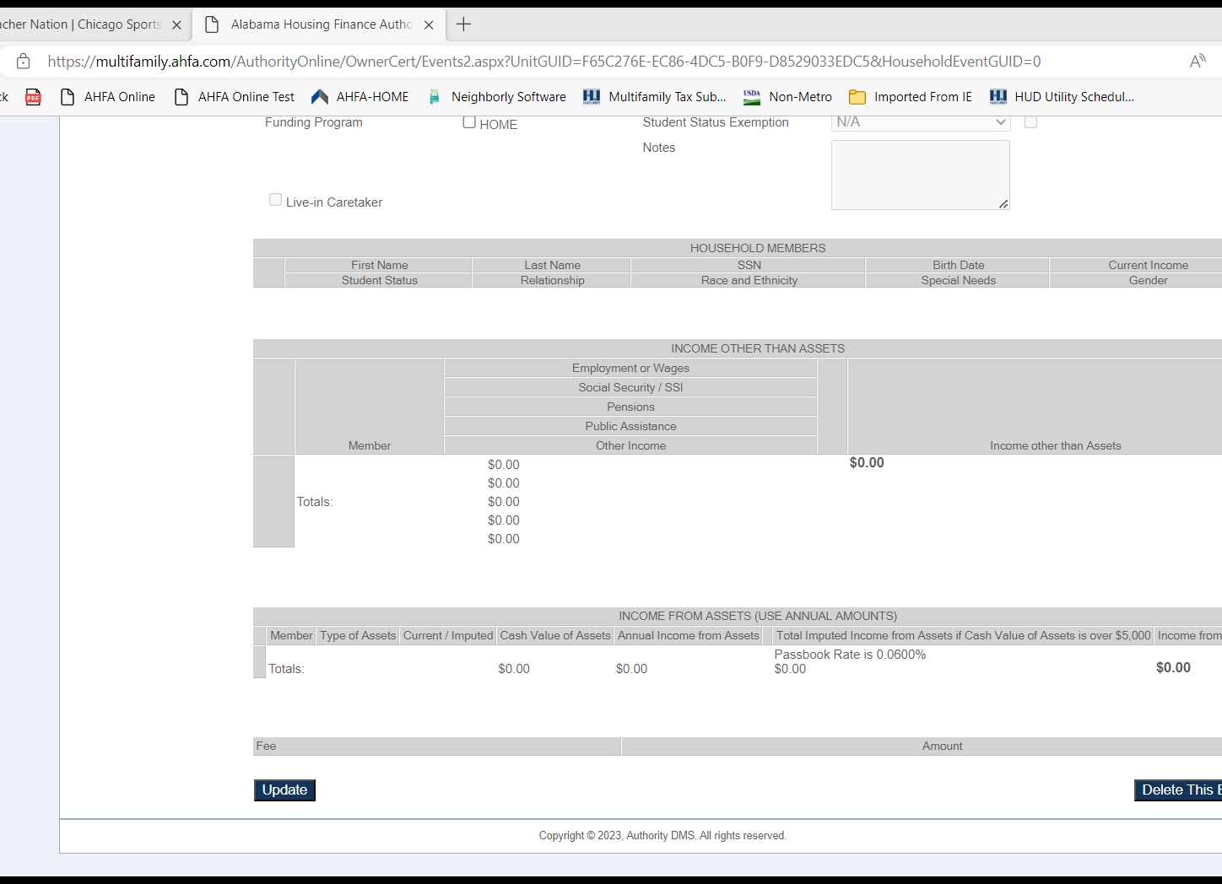
Event Details
Each Household Member must be entered (including an Unborn Child)
Non-Asset Income and Asset Income sections are now Required
Fill these sections out the same as you would if it was the Tenant Income Certification form

Slide 28
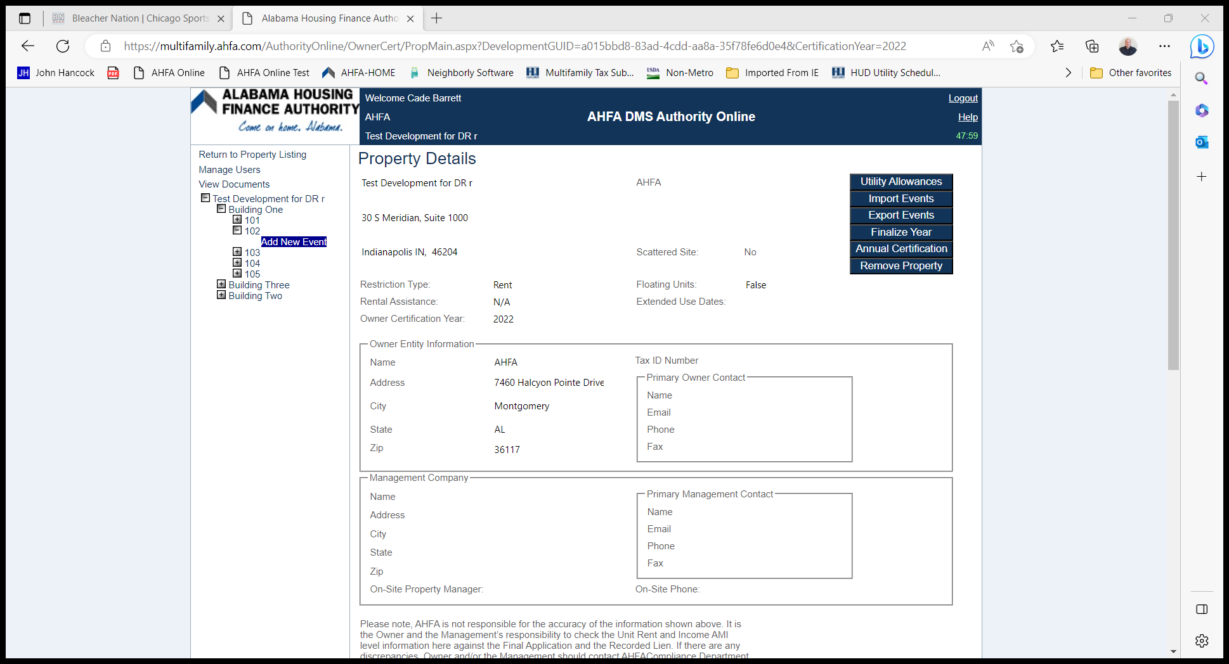
Import Events
NAHMA 2.0
Start Date for each Import is January 1
Must create the utility allowance in AHFA DMS before you import the file
Click Import Events
Upload your XML
Choose the appropriate Utility Allowance for each unit
Click Check For Errors
Go to Property Details and click Export Events to confirm your upload was successful

Slide 29
Finalize Year
All tenant events from January 1st through December 31st MUST be entered before you can finalize.
Before Finalizing the year make sure to check to see if all the tenant events are in AHFA DMS.
This can be done two ways:
Click on Export Events
2. Click on each Unit Number in the Property

Slide 30

Annual Certification
This is NOT an option for HOME Only properties.
An authorized user can enter the Annual Owner Certification through AHFA DMS by clicking on Annual Certification.
Make sure to select this in the appropriate Effective year.
  Due date was March 1, 2023
  The user must go into to the 2022 Effective Year to complete the Annual Certification
Make sure to only provide an answer to questions that apply to the property.
If it does not apply, then choose “N/A”.

Slide 31
Mfcompliance@ahfa.com

