Slide 1
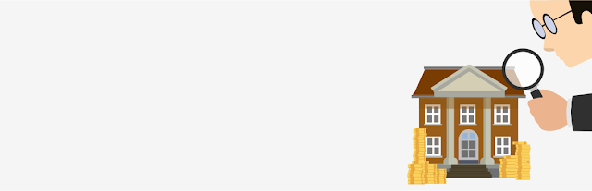
NSPIRE
This Photo by Unknown Author is licensed under CC BY

Slide 2
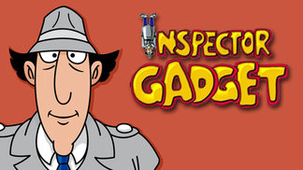
NSPIRE
What is NSPIRE?
  National Standards for the Physical Inspection of Real Estate
NSPIRE has Three (3) Inspectable Areas:
  Unit
  Inside
  Outside
This Photo by Unknown Author is licensed under CC BY-SA

Slide 3
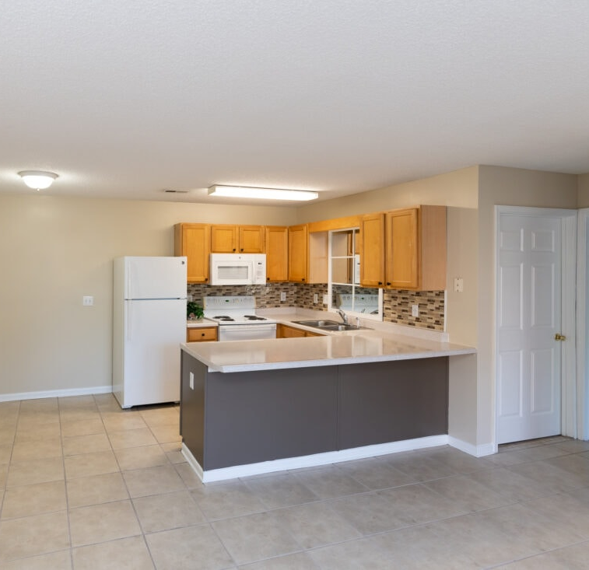
NSPIRE
Unit
A “Unit” of HUD housing refers to the interior components of an individual dwelling, where the resident lives.
This Photo by Unknown Author is licensed under CC BY-NC-ND

Slide 4

NSPIRE
INSIDE
“Inside” refers to the common areas and building systems within the building interior and are not inside a unit. This could include interior laundry facilities, workout rooms, and so on.

Slide 5
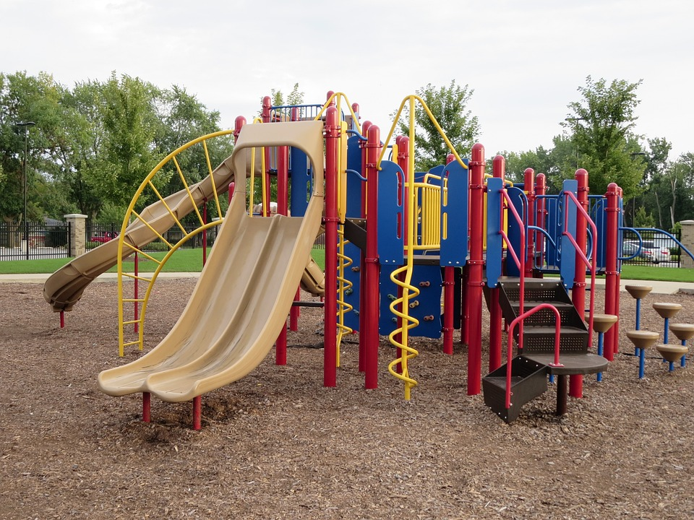
NSPIRE
OUTSIDE
“Outside” refers to the building site, building exterior components, and any building systems located outside of the building or unit. This includes things like playgrounds, sidewalks, and air-conditioning units.

Slide 6

NSPIRE
AHFA is using NSPIRE Standards for the physical inspection process in 2024.

Slide 7

NSPIRE Standards
The standards can be found by searching the HUD website or using the following link:
National Standards for the Physical Inspection of Real Estate (NSPIRE) | HUD.gov / U.S. Department of Housing and Urban Development (HUD)
This Photo by Unknown Author is licensed under CC BY-SA-NC

Slide 8

NSPIRE Facts
Inspections are taking longer.
  Average 56-unit property
  12 units are inspected
  In the past, this would take AHFA about 1-hour
  Now, it takes 2-hours

Slide 9
NSPIRE Facts
Different areas of the unit are being inspected. Here are a few, but this is NOT the complete list:
  Windows
  Stove
    Oven
    Eyes
  All Electric Outlets
  All GFI Outlets
  Bathroom Sink(s)
  Bathroom Shower/Tub
  Hot Water Heater
  Balcony
  Fire Extinguisher

Slide 10
NSPIRE Facts
Correction Timeframe is based on the finding.
24-Hours
30-Days
60-Days

Slide 11
NSPIRE Requirement for AHFA Properties
Management Must Participate in the inspection
It is very important to have Maintenance present or at least in the area so that any 24-hour correction can be made
Make sure your Maintenance is familiar with the NSPIRE Standards

Slide 12
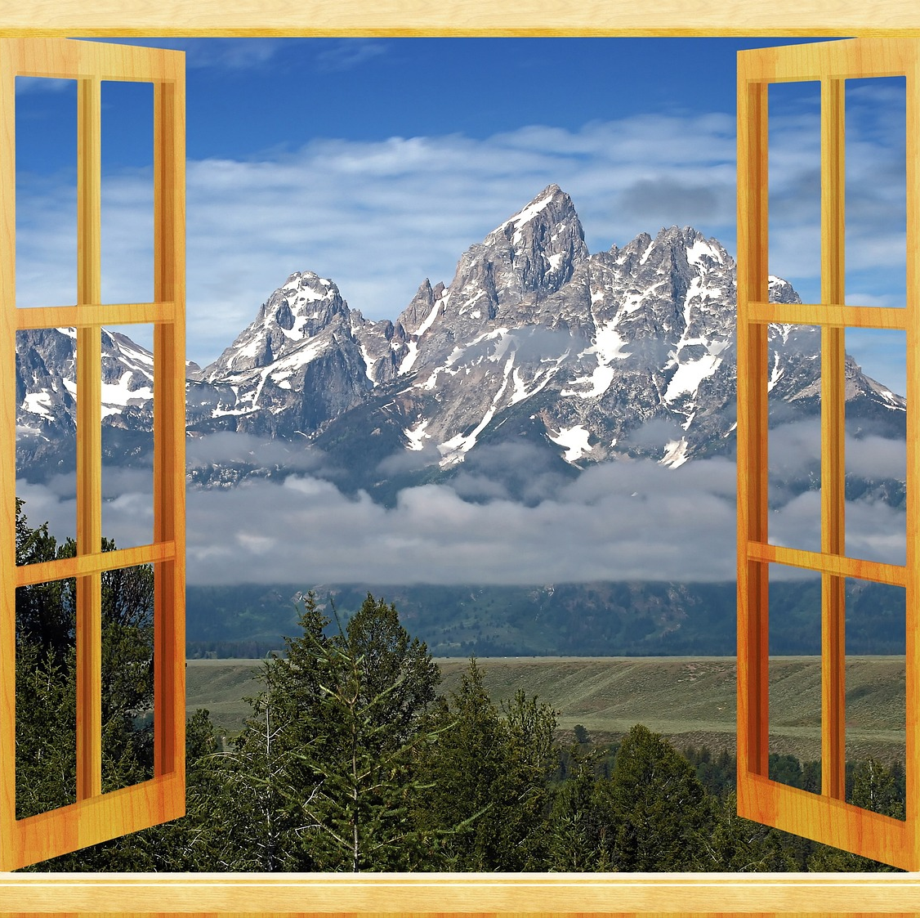
NSPIRE Standards - Example
Window Standard
DEFICIENCY CRITERIA:
Window will not open.
OR
Once opened, window will not stay open without the use of a tool or item.

Slide 13
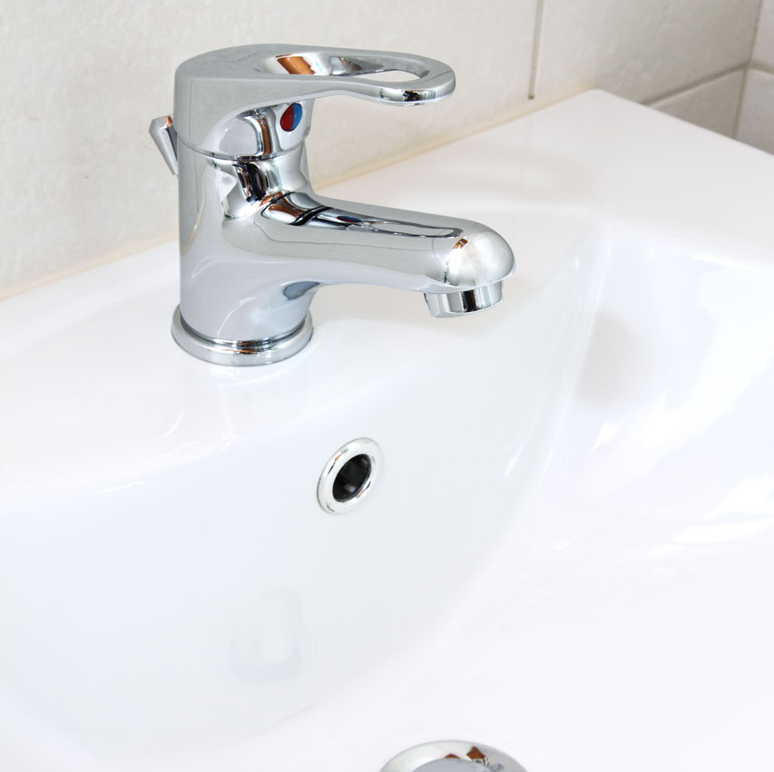
NSPIRE Standards - Example
Sink Standard
DEFICIENCY CRITERIA:
Sink or sink component is damaged (i.e., visibly defective; impacts functionality) or missing (i.e., evidence of prior installation, but now not present or is incomplete) and the sink is not functionally adequate.

Slide 14
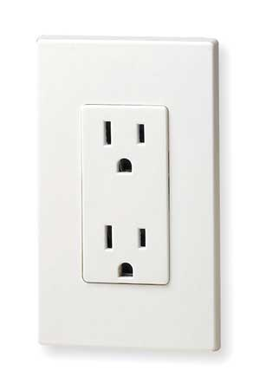
NSPIRE Standards - Example
Electrical Outlet
DEFICIENCY CRITERIA:
Any portion of a visually accessible (i.e., can be reasonably accessed and observed) outlet or switch is damaged (i.e., visibly defective; impacts functionality) such that it may not safely carry or control electrical current at the outlet or switch.
OBSERVATION:
Identify all outlets and switches.
Look at each outlet and switch for signs of damage (e.g., smoke, burn marks, arcing).
This Photo by Unknown Author is licensed under CC BY-SA

Slide 15
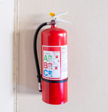
NSPIRE Standard - Examples
Pressure gauge indicates that the fire extinguisher is over or under-charged.
The date on the service tag of any fire extinguisher has exceeded one year.
OR
The fire extinguisher tag is missing or illegible.
OR
A nonchargeable or disposable fire extinguisher is more than 12 years old (based on manufacture date).
Fire extinguisher is damaged (i.e., visibly defective; impacts functionality).
OR
Fire extinguisher is missing (i.e., evidence of prior installation, but now not present or is incomplete).

Slide 16
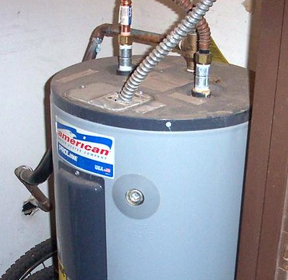
NSPIRE Standard - Examples
Hot Water Heater
If the water heater is located behind a locked door or concealed, request access from the resident or managment.
This Photo by Unknown Author is licensed under CC BY-NC-ND

Slide 17
NSPIRE Standard - Examples
Egress
DEFICIENCY 2 – UNIT: SLEEPING ROOM IS LOCATED ON THE 3RD FLOOR OR BELOW AND HAS AN OBSTRUCTED RESCUE OPENING.
OBSERVATION:
- Identify rooms used for sleeping.
- Visually inspect for any obstructed rescue opening.
Resident-owned property should not be evaluated as an obstruction to the rescue opening.
The following are some examples of conditions that may obstruct a rescue opening:
Window locks that require a key, a tool, or special knowledge or effort to operate (from the interior).
Placement of an item or furniture that is not resident owned and obstructs a rescue opening.
A permanently installed window-mounted air conditioner.

Slide 18
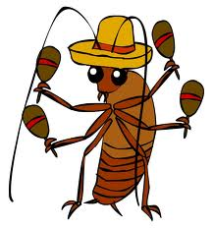
NSPIRE Standard - Example
DEFICIENCY 1 – UNIT: EVIDENCE OF COCKROACHES.
DEFICIENCY CRITERIA: Evidence of cockroaches is found (i.e., a live or dead cockroach, shed skins, droppings, or egg cases).
OBSERVATION:
- Look for a dead or live cockroach, shed skins, droppings (small black specks or smears), and egg cases (brown oblong cases: 5–9mm long).
This Photo by Unknown Author is licensed under CC BY-SA-NC

Slide 19
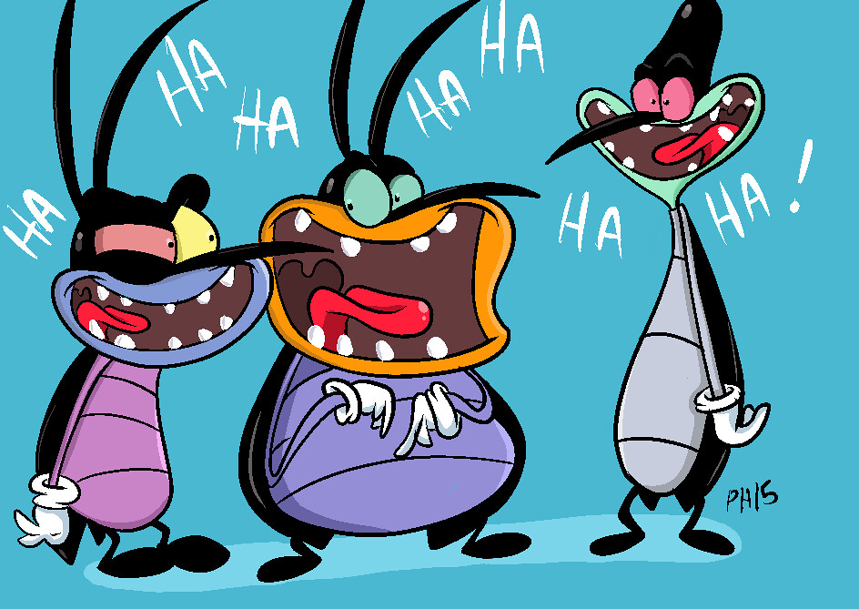
NSPIRE Standards – Example
DEFICIENCY 2 – UNIT: EXTENSIVE COCKROACH INFESTATION.
DEFICIENCY CRITERIA: Sighting of at least one live cockroach in two or more Units during a daytime surface visual assessment.
OR
Sighting of at least one live cockroach in two or more rooms in a Unit during a daytime surface visual assessment.
OBSERVATION:
Look for any live cockroach.
At least one live cockroach in two or more Units during a daytime surface visual assessment is a sign of extensive infestation.
At least one live cockroach in two or more rooms in a Unit during a daytime surface visual assessment is a sign of extensive infestation.
This Photo by Unknown Author is licensed under CC BY

Slide 20
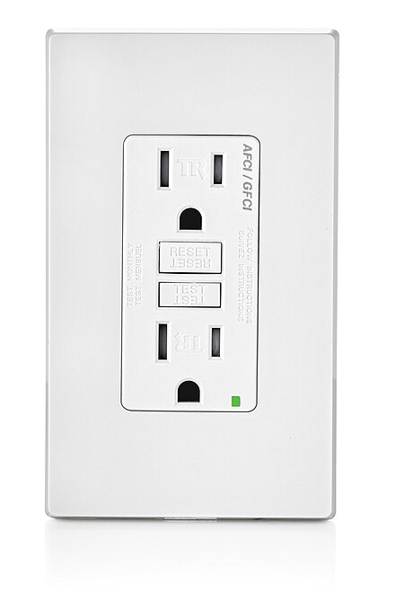
NSPIRE Standard - Example
DEFICIENCY 3 – UNIT: AN UNPROTECTED OUTLET IS PRESENT WITHIN SIX FEET OF A WATER SOURCE.
DEFICIENCY CRITERIA: Outlet is present within six feet of a water source (i.e., sink, bathtub, shower, water faucet, toilet) that is located in the same room.
AND
Outlet is not GFCI protected.
OBSERVATION:
- Identify all outlets within the Unit.
- Identify water sources (i.e., sink, bathtub, shower, water faucet, toilet) within the same room as each outlet.
- Determine if each outlet within six feet of a water source is GFCI protected.
This Photo by Unknown Author is licensed under CC BY-SA

Slide 21
NSPIRE Standard - Example
MORE INFORMATION:
- Outlet protection methods include GFCI outlet, GFCI breaker, or an outlet wired in series that is protected by another GFCI outlet.
- An outlet dedicated to a major appliance (e.g., water heater, HVAC, refrigerator, washing machine, dishwasher, garbage disposal, appliance that is wall-mounted or installed within a cabinet, etc.) should NOT be evaluated under this standard, regardless of its distance from the water source.
- A dedicated outlet is a receptacle outlet that is only capable of serving that specific appliance.
- An outlet located below a countertop and within an enclosed cabinet should not be evaluated under this standard, regardless of its distance from the water source.
- An electrical conductor that is not enclosed or properly insulated should be evaluated under the Electrical – Conductor, Outlet, and Switch standard.
This Photo by Unknown Author is licensed under CC BY-SA

Slide 22
NSPIRE Standard - Example
DEFICIENCY 1 – UNIT: A SHARP EDGE THAT CAN RESULT IN A CUT OR PUNCTURE HAZARD IS PRESENT.
DEFICIENCY CRITERIA: A sharp edge that can result in a cut or puncture hazard that is likely to require emergency care (e.g., stitches) is present within the built environment (i.e., human-made structures, features, and facilities).
OBSERVATION:
- Look throughout the Unit to identify any sharp edge that can result in a cut or puncture hazard.
- If present, determine if the sharp edge is likely to require emergency care if the resident comes into contact with it.
Examples of sharp edges within the Unit include, but are not limited to, broken glass or damaged tile with an exposed edge.

Slide 23
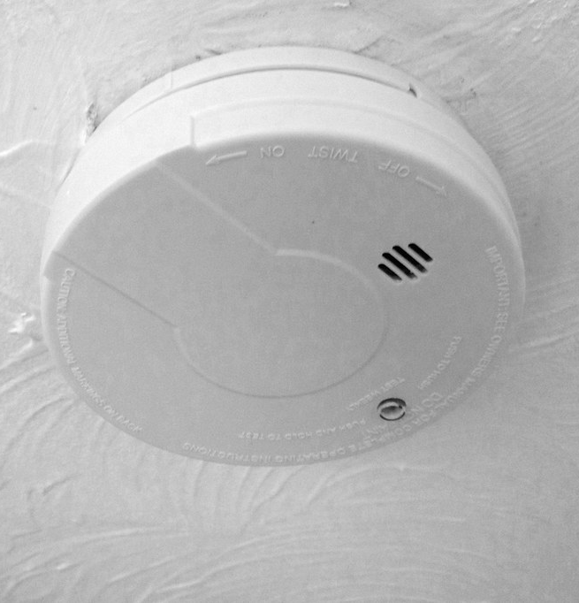
NSPIRE Standard - Example
DEFICIENCY 1 – UNIT: SMOKE ALARM IS NOT INSTALLED WHERE REQUIRED.
DEFICIENCY CRITERIA: Smoke alarm is not installed inside each bedroom.
AND
Smoke alarm is not installed outside the bedroom(s).
AND
Smoke alarm is not installed on each level.
OBSERVATION:
- Observe each location where a smoke alarm is required.
- Verify a smoke alarm is present.
This Photo by Unknown Author is licensed under CC BY-SA-NC

Slide 24
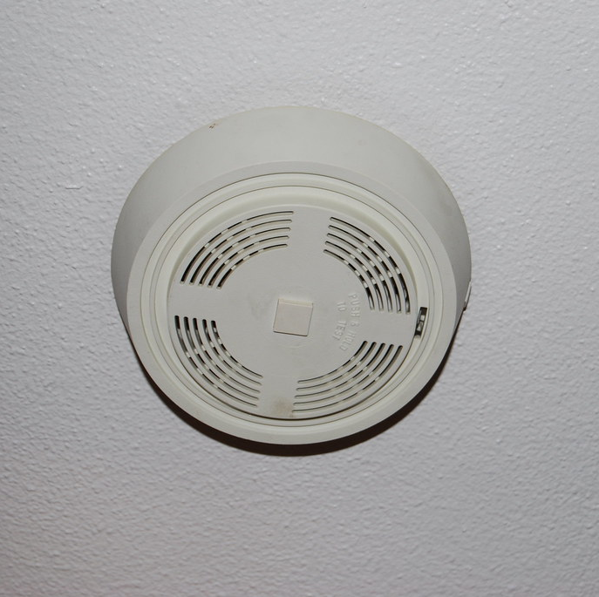
NSPIRE Standard - Example
More Information:
- A smoke alarm installed within a hallway in the immediate vicinity of multiple bedrooms meets the requirement of "outside the bedroom(s)" under this standard.
- A smoke alarm installed outside a bedroom may meet the requirement of "on each level" under this standard.
- If a smoke alarm is missing (i.e., evidence of prior installation, but is now not present or is incomplete) from a non-required area, then it should not be evaluated under this standard.
- If another hazard is present, then it should be evaluated under the respective standard (e.g., an exposed conductor should be evaluated under the Electrical – Conductor, Outlet, and Switch standard).
This Photo by Unknown Author is licensed under CC BY

Slide 25
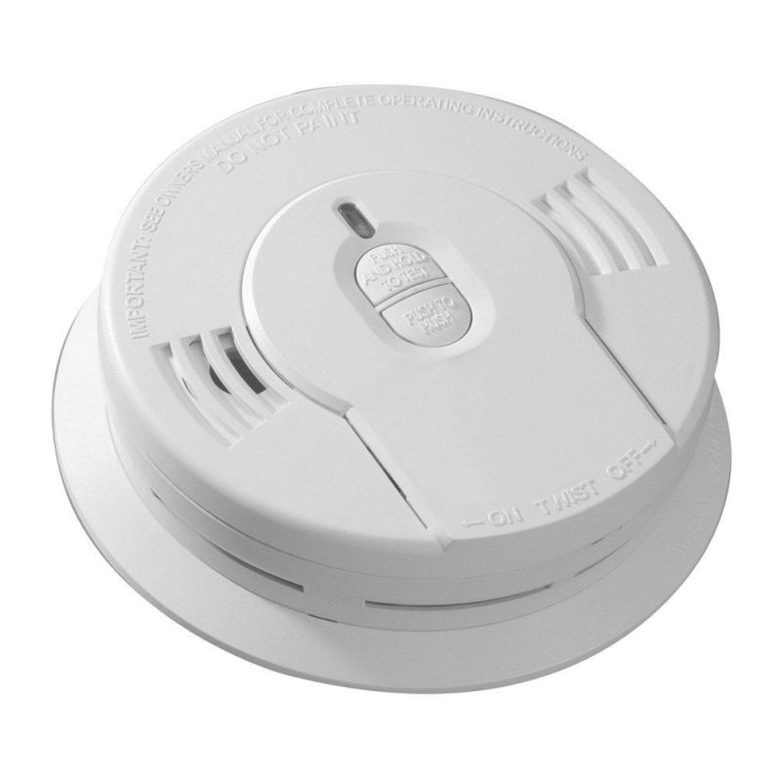
NSPIRE Standard - Example
DEFICIENCY 2 – UNIT: SMOKE ALARM IS OBSTRUCTED.
DEFICIENCY CRITERIA: Smoke alarm is obstructed.
ACTION:
- Determine if the smoke alarm is covered by a foreign object (e.g., plastic bag, shower cap, zip tie, paint, tape).
This Photo by Unknown Author is licensed under CC BY-NC-ND

Slide 26
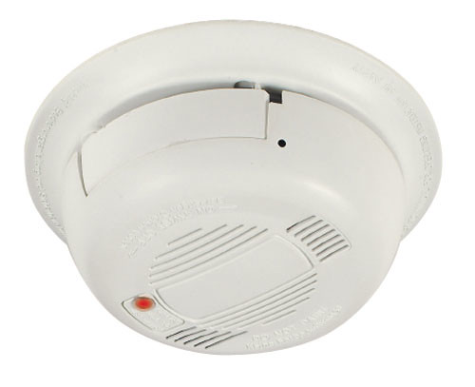
NSPIRE Standard - Example
DEFICIENCY 3 – UNIT: SMOKE ALARM DOES NOT PRODUCE AN AUDIO OR VISUAL ALARM WHEN TESTED.
DEFICIENCY CRITERIA: Smoke alarm does not produce an audio or visual alarm when tested.
ACTION:
- Press the test button and determine if the light on the smoke alarm flashes, strobes, or changes pattern in any way.
- Listen to hear if an alarm is emitted from the smoke alarm at an audible level to alert the resident.

Slide 27
NSPIRE Standard - Example
DEFICIENCY 1 – UNIT: SYSTEM IS BLOCKED, OR PULL CORD IS HIGHER THAN 6 INCHES OFF THE FLOOR.
DEFICIENCY CRITERIA: System is blocked.
OR
Pull cord end is higher than 6 inches off the floor.
OBSERVATION:
- Look for a call-for-aid system along the walls.
- Look to see if a cord is present if required; not all call-for-aid systems will have a cord, some may have a button.
- Look at the call-for-aid system and visually inspect for any obstruction that would prevent a resident from accessing the system (e.g., furniture and equipment, clothes, plants, etc.).

Slide 28
NSPIRE Standard - Example
ACTION:
- If a cord is present, measure the distance between the end of the pull cord and the floor to determine if it is greater than 6 inches
More Information:
- If the call-for-aid system is a button-only device, then do not record a deficiency for a pull cord end that is higher than 6 inches off the floor.

Slide 29
NSPIRE Standard - Example
DEFICIENCY 2 – UNIT: SYSTEM DOES NOT FUNCTION PROPERLY.
DEFICIENCY CRITERIA: A call-for-aid system does not emit sound or light or send a signal to the annunciator.
OR
The annunciator does not indicate the correct corresponding room.
OR
Pull cord is missing.
OR
Pull cord is tied up such that it cannot be engaged.

Slide 30
NSPIRE Standard - Example
OBSERVATION:
- Look for a call-for-aid system along the walls.
- Look to verify that a cord is present, if so designed.
- Listen to verify that the system emits an audible alarm, if so designed.
- Verify the system emits a visual alarm, if so designed.
MORE INFORMATION:
- If the property has third-party documentation of a call-for-aid inspection, then the inspector does not need to test call-for-aid stations. Instead, the inspector should:
- Verify that the documentation addresses all parts of the call-for-aid system.
- Verify that the third-party documentation is dated within the last 12 months of the inspection date.
- If the call-for-aid system is abandoned:
- Do not evaluate call-for-aid systems if all pull stations have been removed and all that remains are the indicator lights, audible indicators, or annunciator panel.
- The primary consideration is that no part of the user interface remains.
- If the call-for-aid system is a button-only device, then do not record a deficiency for a missing pull cord.

